Slide 1

TSP OPTIMIZATION (using Particle Swarm Optimization and Ant Colony Optimization)
Enrollment No. - 9913103672
Name - Gaurav Chauhan
Name of supervisor(s) - Dr. Mukesh Saraswat
May - 2017
Submitted in partial fulfillment of the Degree of
Bachelor of Technology B. Tech
in
Computer Science Engineering
DEPARTMENT OF COMPUTER SCIENCE ENGINEERING & INFORMATION TECHNOLOGY
JAYPEE INSTITUTE OF INFORMATION TECHNOLOGY, NOIDA

Slide 2
The Travelling Salesman Problem describes a salesman who must travel between N cities. The order in which he does so is something he does not care about, as long as he visits each one during his trip, and finishes where he was at first. Each city is connected to other close by cities, or nodes, by airplane, or by road or railway. Each of those links between the cities has one or more weights (or the cost) attached. The cost describes how "difficult" it is to traverse this edge on the graph, and may be given, for example, by the cost of an airplane ticket or train ticket, or perhaps by the length of the edge, or time required to complete the traversal. The salesman wants to keep both the travel costs, as well as the distance he travels as low as possible.

Slide 3
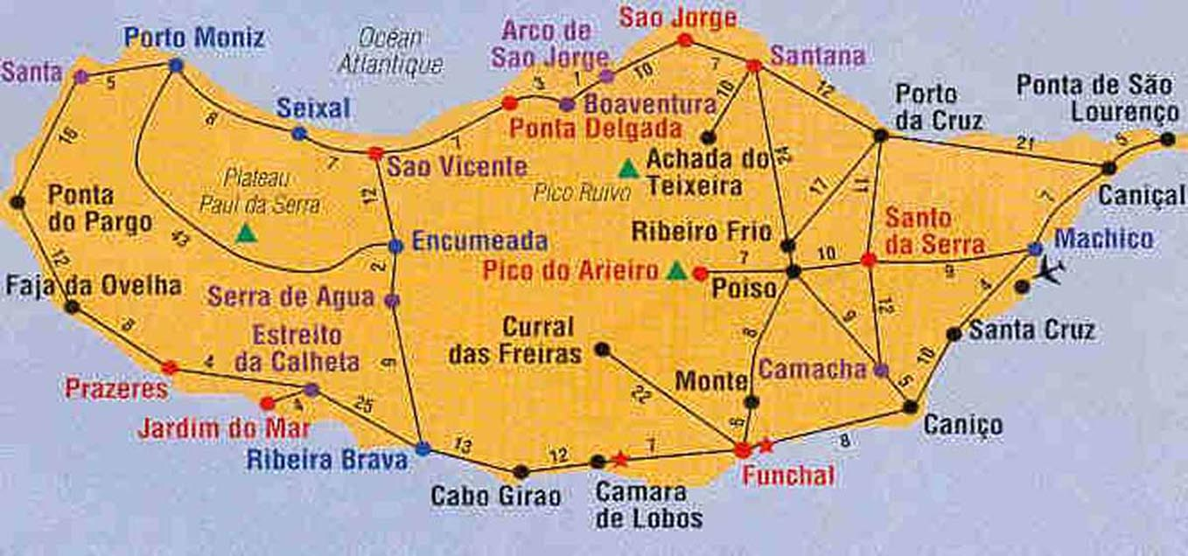
Madeira Island (west of Morocco in Atlantic ocean)
Find a tour with minimum distance, visiting every city only once

Slide 4
Traveling Salesman Problem
Theoretical interest
Basic NP-complete problem (➔ not easy)
(only to traverse 10 cities , the solution space , i.e, the total number of possible solutions is 181440 )
1993-2001: +150 articles about TSP in INFORMS & Decision Sciences databases
Practical interest
Vehicle Routing Problem
Genetic/Radiated Hybrid Mapping Problem
NCBI/Concorde, Carthagène, ...

Slide 5
Variants
Euclidean Traveling Salesman Selection Problem
Asymmetric Traveling Salesman Problem
Symmetric Wandering Salesman Problem
Selective Traveling Salesman Problem
TSP with distances 1 and 2, TSP(1,2)
K-template Traveling Salesman Problem
Circulant Traveling Salesman Problem
On-line Traveling Salesman Problem
Maximum Latency TSP
Minimum Latency Problem
Max TSP
Traveling Preacher Problem
Bipartite TSP
Remote TSP
Precedence-Constrained TSP
Exact TSP
The Tour Cover problem
Time-dependent TSP
The Angular-Metric Traveling Salesman Problem

Slide 6


Introduction to the PSO: Origins
Particle swarm optimization (PSO) is a population based stochastic optimization technique developed by Dr. Eberhart and Dr. Kennedy in 1995, inspired by social behavior of bird flocking or fish schooling.

Slide 7
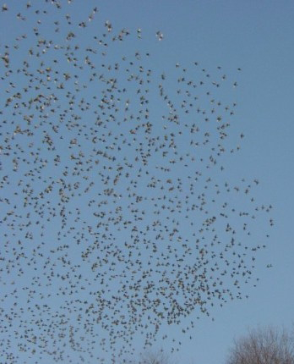
Introduction to the PSO: Concept
Uses a number of agents (particles) that constitute a swarm moving around in the search space looking for the best solution
Each particle in search space adjusts its “flying” according to its own flying experience as well as the flying experience of other particles

Slide 8
Introduction to the PSO: Concept
Collection of flying particles (swarm) - Changing solutions
Search area - Possible solutions
Movement towards a promising area to get the global optimum
Each particle keeps track:
its best solution, personal best, pbest
the best value of any particle, global best, gbest

Slide 9
Introduction to the PSO: Concept
Each particle adjusts its travelling speed dynamically corresponding to the flying experiences of itself and its colleagues
Each particle modifies its position according to:
its current position
its current velocity
the distance between its current position and pbest
the distance between its current position and gbest

Slide 10


Introduction to the PSO: Concept
Classical equation for Velocity is :
Vi = is the velocity value
, , I is a uniform random value in the interval [0,1]
Pbesti = is the best postion of ith item
Gbest = is the best position of all items
Xi = is the current position of particle
V_MAX is max value of velocity
Velocity equation in my proposed approach:
Vi = V_MAX * (Gbest /Pbest)
The particles are updated as :

Slide 11
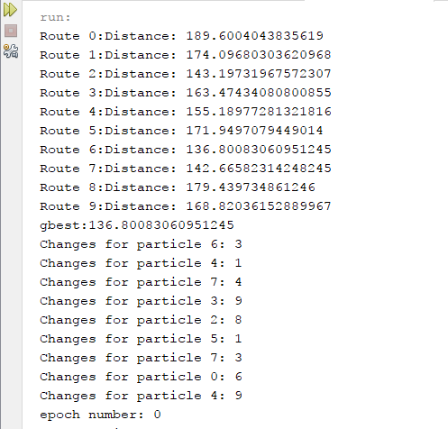
Output screen:

Slide 12
What is Ant Colony Optimization?
Probabilistic technique.
Searching for optimal path in the graph based on behaviour of ants seeking a path between their colony and source of food.
Meta-heuristic optimization

Slide 13
ACO Concept:
Overview of the Concepts:
Concept
Ants navigate from nest to food source. Ants are blind!
Shortest path is discovered via pheromone trails.
Each ant moves at random
Pheromone is deposited on path
More pheromone on path increases probability of path being followed

Slide 14
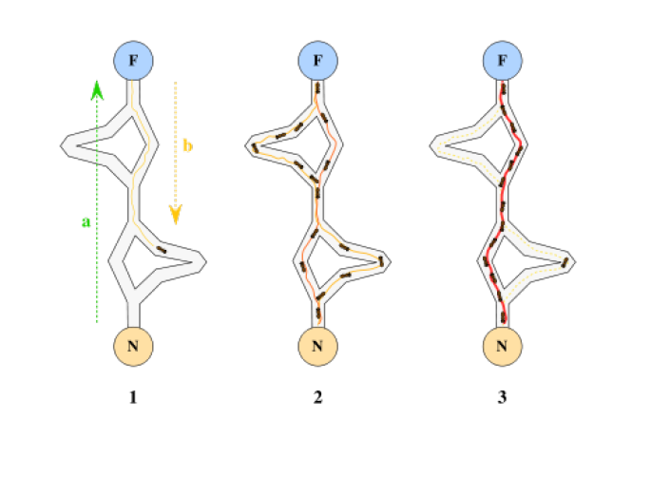

Slide 15
ACO System
Overview of the System:
Virtual trail accumulated on path segments
Path selected at random based on amount of "trail" present on possible paths from starting node
Ant reaches next node, selects next path
Continues until reaches starting node
Finished tour is a solution.
Tour is analyzed for optimality

Slide 16
Meta-heuristic
Heuristic method for solving a very general class of computational problems by combining user-given heuristics in the hope of obtaining a more efficient procedure.
ACO is meta-heuristic
Soft computing technique for solving hard discrete optimization problems

Slide 17
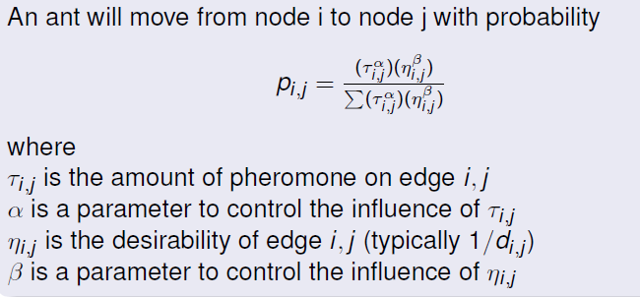
ACO - Construct Ant Solutions

Slide 18
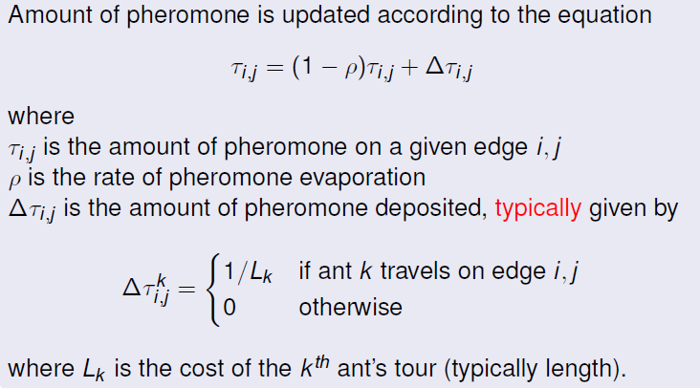
ACO - Pheromone Update

Slide 19
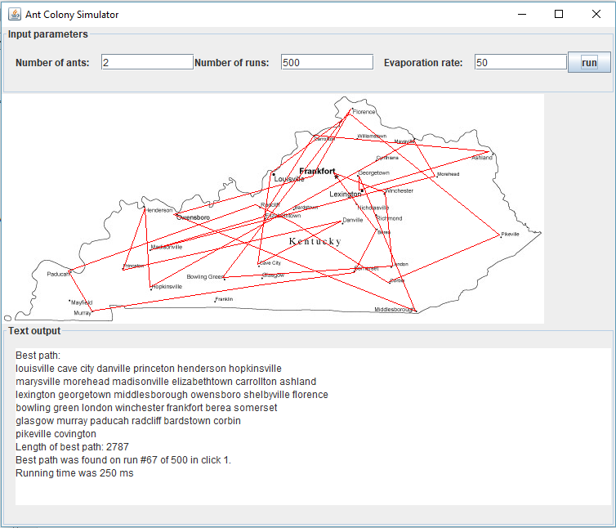
Output screen:

Slide 20
Advantages of ACO
Inherent parallelism
Positive Feedback accounts for rapid discovery of good solutions
Efficient for Traveling Salesman Problem and similar problems
Can be used in dynamic applications (adapts to changes such as new distances, etc)

Slide 21
Disadvantages of ACO
Theoretical analysis is difficult
Sequences of random decisions (not independent)
Probability distribution changes by iteration
Research is experimental rather than theoretical
Time to convergence uncertain (but convergence is gauranteed!)

Slide 22
Conclusion:
In the comparative study of implementation of both of these algorithms on travelling salesman problem , Ant Colony Optimization was found to give better result than the particle swarm optimization because when both algorithms were executed with same number of particles (10) , the running time of both algorithms to find the shortest route was almost identical , while ACO was working on dataset of 40 cities and PSO was working on dataset of only 8 cities , which concludes that Ant Colony Optimization(ACO) algorithm is way much faster that PSO and hence is a better approach for in the process of solving the Travelling Salesman Problem.

